Slide 1
DO YOU CONTINUE CRM ON S4 on premise?
We offer the following
project accelerators:
MS Office
Outlook Integration
Data
Migration
Tool
WEB UI
Migration
Tool
Data
Exchange Framework

Slide 2
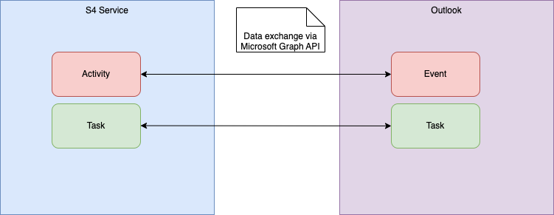
OutLOOK INtegration
Server-side integration of S4 Service with Microsoft Outlook via Microsoft Graph, enabling mutual creation, update and delete of tasks and activities.
Benefits:
Seamless integration of Activtiy and Taskmanagement
High data quality in Outlook and S4 Service
Enabler for further process automation
Back
Notes:
Access via technical user (App Access) or personal user
OAuth2 secured

Slide 3
Data Migration Tool
Tooling to support migration of business transaction data from CRM to S4 Service.
Benefits:
Supports Initial and Delta Migration
Support of all S4 Service Transaction Types
Support for Transfer and Mapping of Custom Data
Monitor Progress and Errors
Back
Notes:
Access via technical user (App Access) or personal user
OAuth2 secured

Slide 4
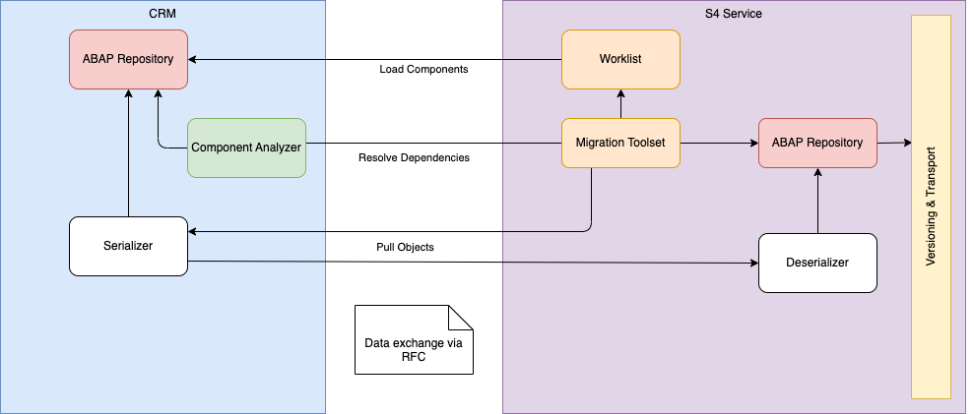
Web ui Migration Tool
Toolset that offers various functions to support migration of Components that have been developed or enhanced using the Web Client UI Framework.
Benefits:
Worklist to manage Migration Tasks
Easy and reliable transfer of all objects that constitute a component
Support to handle data model changes between CRM <-> S4
Copy and adjust UI-Configurations
Back
Notes:
Access via technical user (App Access) or personal user
OAuth2 secured

Slide 5
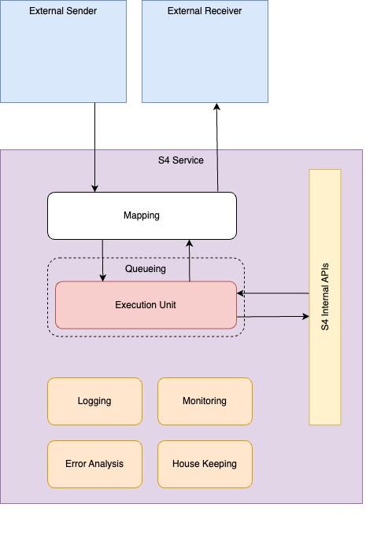
Data Exchange Framework
Framework that allows to build interfaces with external systems in a streamlined way
Benefits:
Leverages scalability, queueing and restart functions of bgRFC framework
Unified infrastructure for support processes, e.g. Monitoring
Easy to implement execution units, heavy lifting is up to the framework
Back
Notes:
Access via technical user (App Access) or personal user
OAuth2 secured

Slide 6
In case of interest, we propose a free-of-charge due diligence done by our Solution Architect on your systems, in order to provide the exact offer and pricing for your custom solution.
NOTE: In general, we expect 50% of savings compared to your own in-house built solutions

Slide 7
ARNE HUSEMANN
CRM SOLUTION ARCHITECT
Professional background
Senior ABAP OO developer and architect in the area of SAP CRM, SAP S/4 HANA and SAP BTP
Several years of experience in front-end development with UI5
15 years of experience in the IT industry (since 9.2009) and 15 years of experience with SAP systems with a focus on SAP CRM, SAP S/4 HANA (BP, CVI, Service) and SAP BTP
Relevant project experience - excerpt
01/2023 - now, international insurance company
Lead CRM consultant and technical architect for the CRM to S/4 service migration
Design and implementation of central functions such as business transactions, middleware and groupware integration
Enhancements to the S4 data model for the business objects transaction, business partner and product
Development of various tools to support the migration, including the transfer of WUI components
01/2022 - 12/2022, multinational software company
One of three architects with a development function for the project, which implements the creation and management of entitlements for the use of software and services. The project also includes the integration into the contract systems (CRM & S/4HANA) as well as the integration of other systems (provisioning, measurement, notification ...)
Implementation of requirements through configuration and JavaScript implementation in cloud-based Entitlement Management System
SAP ABAP/OO development, Web UI development, JavaScript development
Creation of a test concept and implementation of unit tests (ABAP and JavaScript) and API tests using Postman
Technical documentation
04/2021 - 12/2021, conglomerate
Lead CRM consultant and technical architect for the re-implementation of a CRM solution based on S/4HANA.
Conducting a feasibility study and creating a prototype for the Restful ABAP Programming Model (RAP) as the basis for the new architecture
Conception and implementation of solutions for requirements, taking into account a high degree of automation with regard to tests
Extensions to the S/4 data model for the business process (AET and Custom Fields and Logic)
Development of oData services for creating and processing various business transaction types, including draft handling and validation of entries
Special fields
Functional and technical expertise
Analysis, conception and implementation of solutions in the area of: SAP CRM (Interaction Center, Sales, Service) SAP S/4 HANA (Customer Management, Subscription Order Management) Uniserv address and duplicate check
Consulting in the area of master data management, activity and opportunity management
excellent ABAP/ABAP OO knowledge
very good JavaScript and Typescript knowledge
exxtensive experience in object-oriented modeling & design patterns
Web services (SOAP and oData/REST)
UI5 Development
Experience in development of SAP Cloud solutions with Restful ABAP Programming Model and Cloud Application Programming Model
agile project methods
several years of experience in creating concepts for test automation and their implementation
SAP Certified Development Associate - SAP Fiori Application Developer
SAP Certified Development Associate - SAP Cloud Platform
SAP Certified Application Associate - CR Fundamentals with SAP CRM 7.0
Languages
German (mother tongue)
English (fluent)
French (basic knowledge)

Slide 8
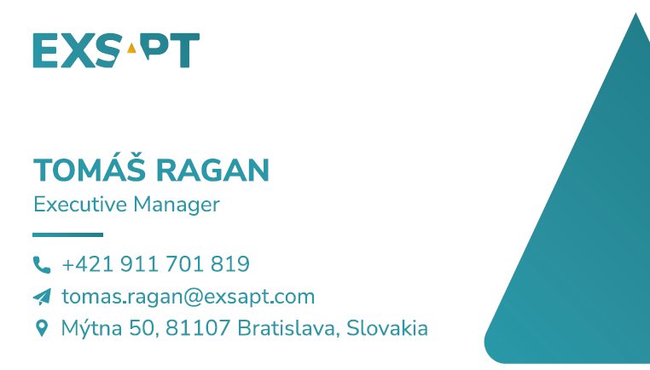
contactS
For business related matters, please kindly contact:
For legal related matters, please kindly contact:
FOTO
FOTO

Slide 9
www.exsapt.com

Slide 10
EXECUTIVE SUMMARY
EXSAPT is primarily focused to deliver nearshore expert SAP services. Our solution stands on two key pillars providing the highest quality of nearshore service delivery, while ensuring the lowest possible rates for SAP application management work on the market.
High Quality People
We are bringing Highly Experienced SAP Consultants together.
Long-Term Partnership
We are offering a long-term partnership to meet the strategic financial targets.

Slide 11
OUR vision and activity
EXSAPT limited liability company and its delivery concept is an initiative of highly skilled SAP experts working previously for multiple international clients with long-term experience from global consulting corporations. Name EXSAPT stands for EXperts in SAP Technology.
The main vision of EXSAPT is simply to provide more for less, focus on delivery quality and minimize the unnecessary overheads. Flexibility, agility and ability to solve any challenge is the credo of EXSAPT management and its delivery team. Deliver Exactly to the client Expectations is our mission.
EXSAPT is committed to employ highly skilled SAP professionals only, with qualification and capabilities proven and guaranteed by the core team, which ensures our clients to cooperate with the best people on the market. We are leveraging a vast network built over many years based on friendship and trust, as well as close business relations of highly experienced people from previous jobs and projects.
The primary source location of our SAP professionals is a geography unit called “V4 region" (i.e. Slovakia, Poland, Hungary and Czech Republic) including a special connection with colleagues from Romania.

