Slide 1
Enriching SAP Business Suite Apps with Modern AI Technology Using SAP BTP
James Wood
Principal Consultant, Bowdark

Slide 2
SAP BTP as a Digital On-Ramp to Modern AI Technologies
Extending the Reach of SAP BTP: Multi-Cloud Solutions
Exploring Practical AI Use Cases
Transforming User Experiences: Moving Beyond Forms Over Data
Wrap-up

Slide 3
SAP BTP as a Digital On-Ramp to Modern AI Technologies

Slide 4
SAP BTP: A Brief Introduction
The SAP Business Technology Platform (SAP BTP) is SAP’s cloud platform-as-a-service (PaaS) offering focused on helping customers achieve their digital innovation goals.
With SAP BTP, customers have a one-stop shop for application development, integration, AI, data management, and analytics.
SAP offers a wide array of flexible, modular services that empower customers to rapidly build SAP extension solutions.
SAP BTP sits at the heart of SAP’s clean core philosophy and is SAP’s recommended platform for building digital transformation solutions going forward – regardless of whether you’re running SAP in the cloud or in an on-premises landscape.

Slide 5
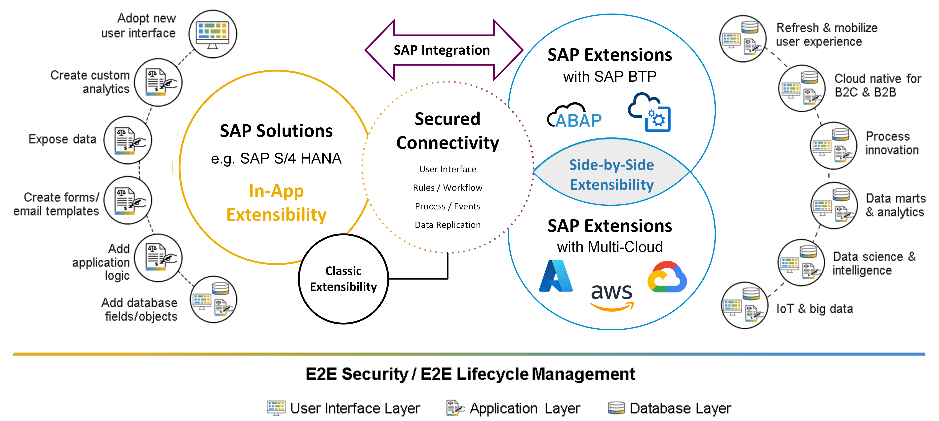

Slide 6
Why SAP BTP?
If you have designs on integrating AI technology into your on-premises SAP Business Suite systems, you have no choice but to look outside of the SAP NetWeaver stack:
ABAP is NOT suited for AI development
Aside from a few ML libraries built into SAP HANA, there’s no built-in AI support within SAP NetWeaver
SAP BTP makes for a good sidecar solution due to its flexible integration with complex and proprietary SAP integration technologies (e.g., RFCs). With SAP BTP, developers have access to:
AI-friendly programming environments like Python (e.g., via Cloud Foundry and/or Kyma)
AI-centric services such as SAP AI Core and Document Information Extraction

Slide 7
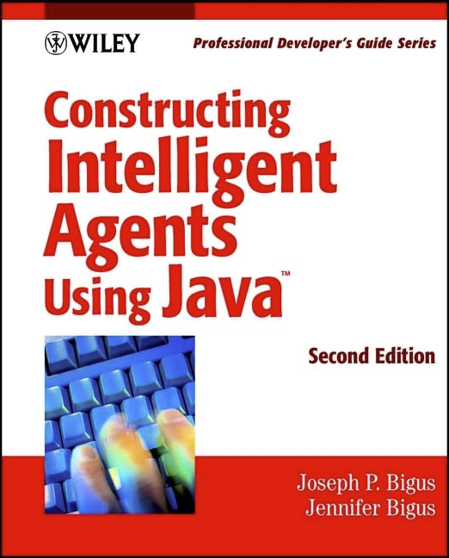
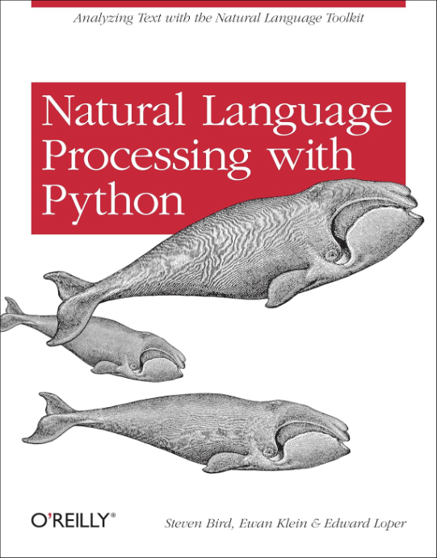
SAP & AI: A Little Late to the Party
2016:
SAP bundles machine learning libraries with the SAP HANA 2.0 release
2021:
SAP rebrands its Cloud Platform to SAP Business Technology Platform (BTP)
2001:
SAP ICM & Business Server Pages introduced
2002:
SAP NetWeaver and NetWeaver Java introduced
2013:
SAP introduces the SAP HANA Cloud Platform
2002:
SAP R/3 Enterprise & Web AS 6.20 released
2010:
SAP HANA initially introduced
2013:
SAP Fiori initially introduced
2017:
SAP introduces its SAP Leonardo digital innovation system
While SAP was busy modernizing its legacy Basis stack, the industry at large was making significant progress with AI & ML technologies
Written in 2001
Written in 2007
Written in 2009

Slide 8
SAP BTP Landscape Overview
Firewall
SAP Business Suite
Cloud Foundry
OData Service
SAP Gateway
HTTPS
TLS Tunnel
Application Server
ABAP
Kyma Runtime
Connectivity
Service
RFC
RFM/BAPI
Cloud Hyperscalers
HTTPS
sFTP
SAP AI
Core
Document
Information
Extraction
Business
Entity
Recognition
NFS
Object Store
Database

Slide 9
Extending the Reach of SAP BTP: Multi-Cloud Solutions

Slide 10
Why Multi-Cloud?
While SAP BTP provides some powerful AI services, its service catalog pales in comparison to the AI and ML-related tools and services offered by hyperscalers such as Microsoft, Amazon, and Google. Some notable offerings here include:
Graphical and/or low-code AI development tools
Access to cutting edge AI services such as those provided by OpenAI
Pre-built environments for getting up and running quickly with AI frameworks like TensorFlow
Simplified access to datasets beyond those generated from SAP data (e.g., weather data from NOAA)
These services can be used separately or in conjunction with SAP BTP - it’s all really a matter of preference.

Slide 11
SAP BTP Landscape Overview: Revisited
Firewall
SAP Business Suite
Cloud Foundry
OData Service
SAP Gateway
HTTPS
TLS Tunnel
Application Server
ABAP
Kyma Runtime
Connectivity
Service
RFC
RFM/BAPI
Cloud Hyperscalers
HTTPS
sFTP
SAP AI
Core
Document
Information
Extraction
Business
Entity
Recognition
NFS
Object Store
Database

Slide 12
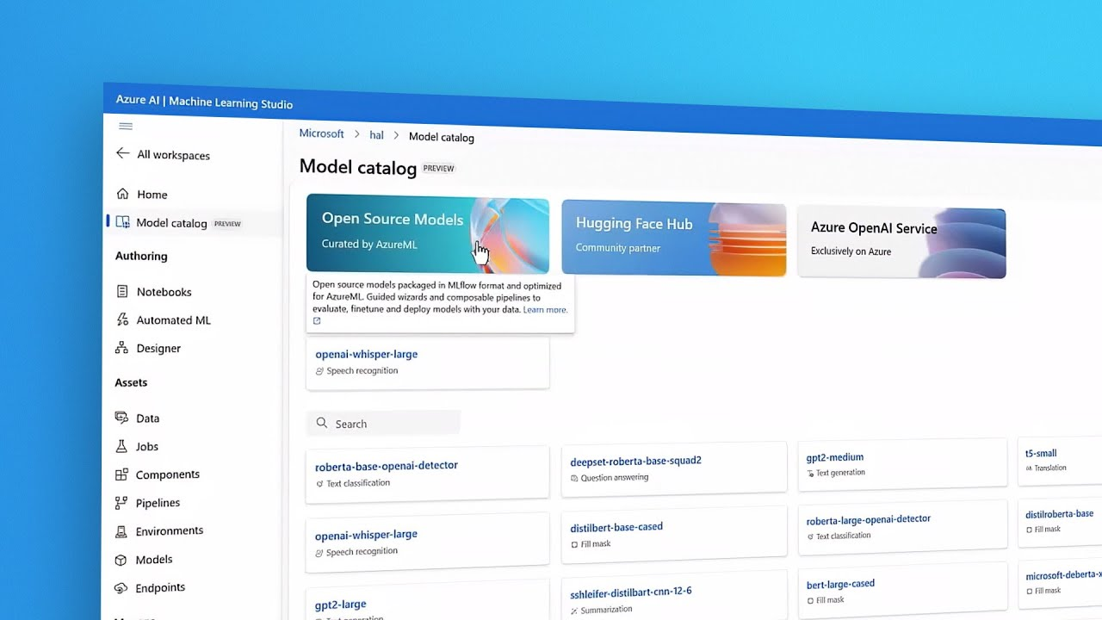
Example: Working with the Azure AI Studio
Pre-built templates, models and samples to get you up and running quickly.

Slide 13
Exploring Practical AI Use Cases

Slide 14
Integrating AI Technology into SAP Business Suite Apps
Between SAP BTP and hyperscaler connectivity services, there are many ways to connect SAP Business Suite systems with AI services:
(Anonymized) data can be synced via files, data transfer tools like SAP SLT, and web service calls.
Trained models can be consumed from ABAP code using REST API calls.
In many respects, the challenges with integration are more on the functional side when it comes to determining how to incorporating AI technology into process flows (either in the foreground or background).

Slide 15
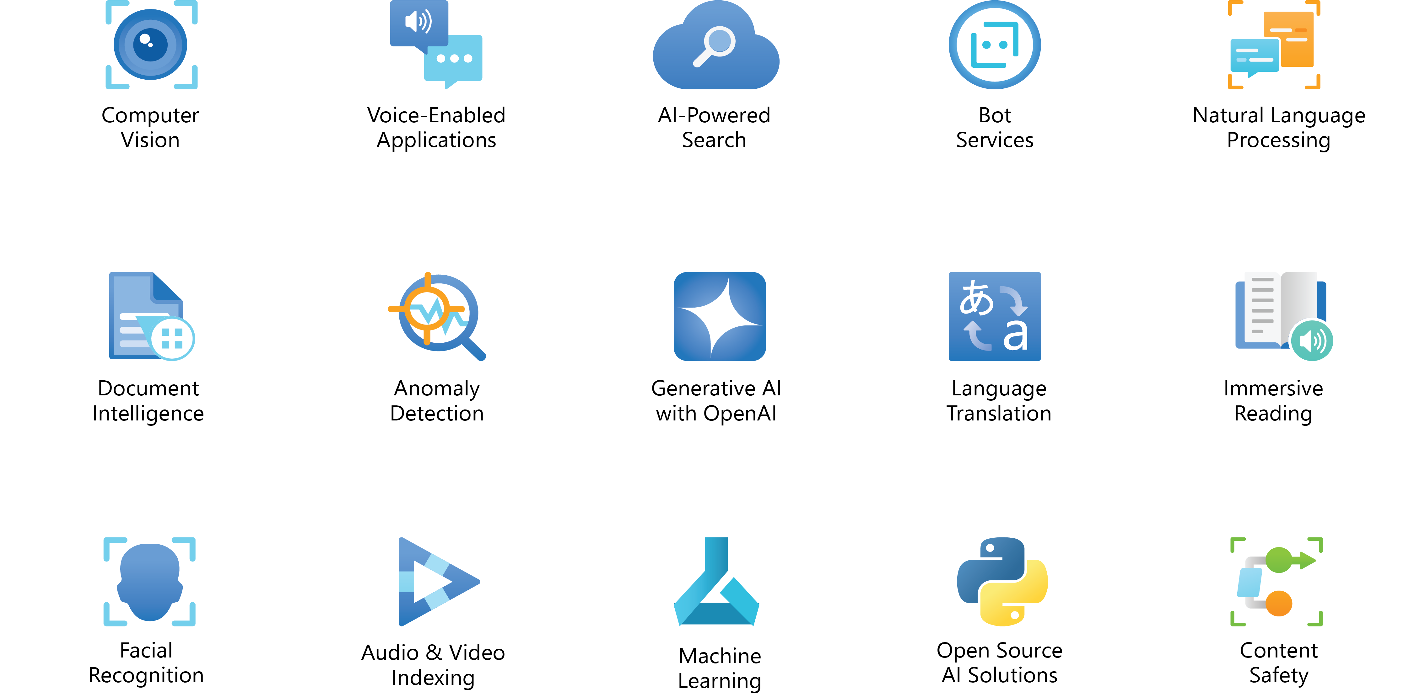
Common AI Application Cases

Slide 16
Use Case: Anomaly Detection
Scenario: Inspectors periodically inspect equipment in the field and record the results in measurement documents inside of SAP Enterprise Asset Management (formerly SAP PM)
Approach:
An ABAP program is built to export X years’ worth of measurement documents and corresponding equipment repair history data. The data is dumped to a flat file (e.g., CSV file) and exported out of SAP.
The historical data is used to train an anomaly detection model to identify situations where measurement point values reach/exceed a threshold that will lead to an eventual outage.
The trained model is published to a web services endpoint.
As new measurement documents are posted, a call is made to the web services endpoint to predict if a failure’s eminent and then respond accordingly.

Slide 17
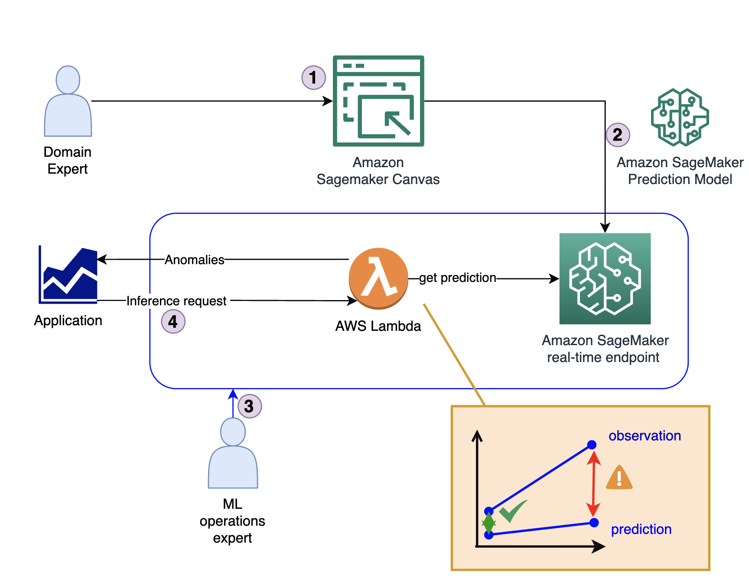
Use Case: Anomaly Detection (Cont.)
Anomaly detection models are built using Amazon Sagemaker

Slide 18
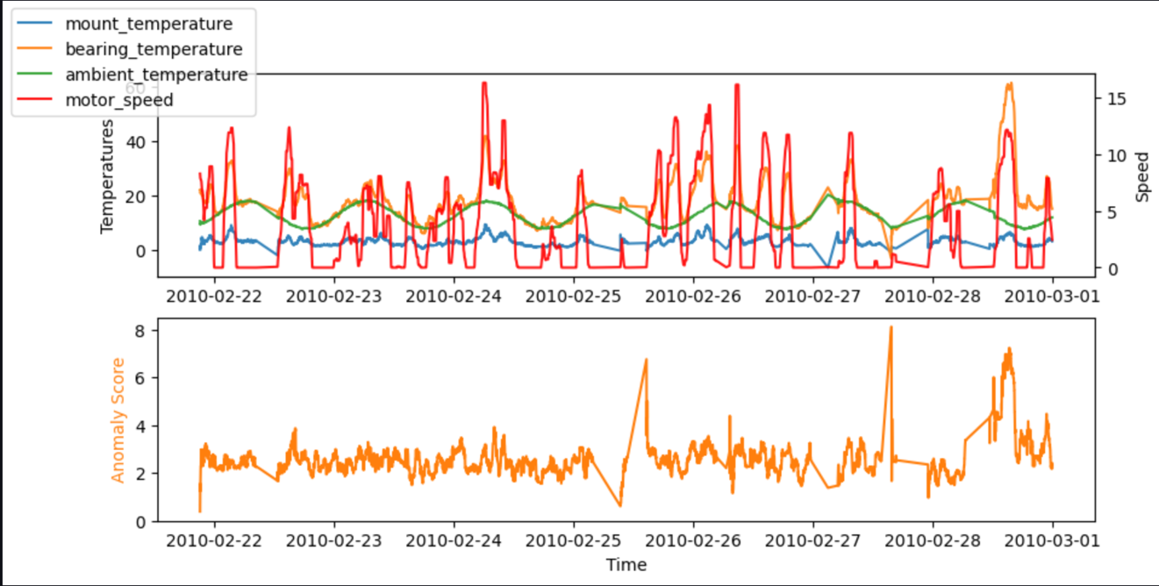
Use Case: Anomaly Detection (Cont.)
If anomalies are detected, an event is triggered to kick off an interface to create a service notification back in SAP

Slide 19
Use Case: AI-Based Search
Scenario: You want to build a complex, AI-based search engine to make it easy for users to find what they’re looking for. Rather than going outside of SAP, you want to incorporate the advanced search capabilities directly into GUI transactions, etc.
Approach:
An ABAP program is built to export raw data about the object(s) you want to search on. For example, SAP materials, corresponding characteristic values, and custom Z-fields.
The raw data is fed into the AI-based search service for indexing.
The search index is published and made accessible via a REST API.
Optional: The search API is enhanced with natural language processing capabilities of services like OpenAI.
The search API is consumed from within SAP via search help exits and other enhancement points.

Slide 20
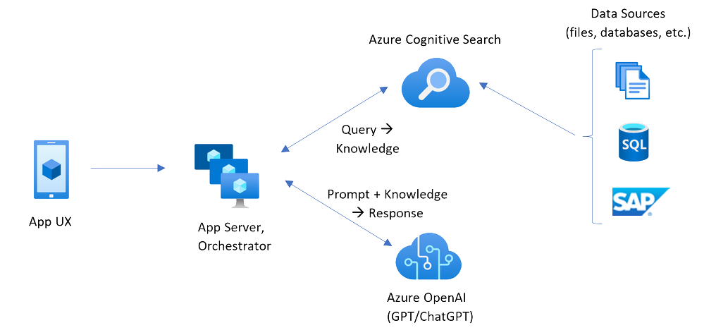
Use Case: AI-Based Search (Cont.)

Slide 21
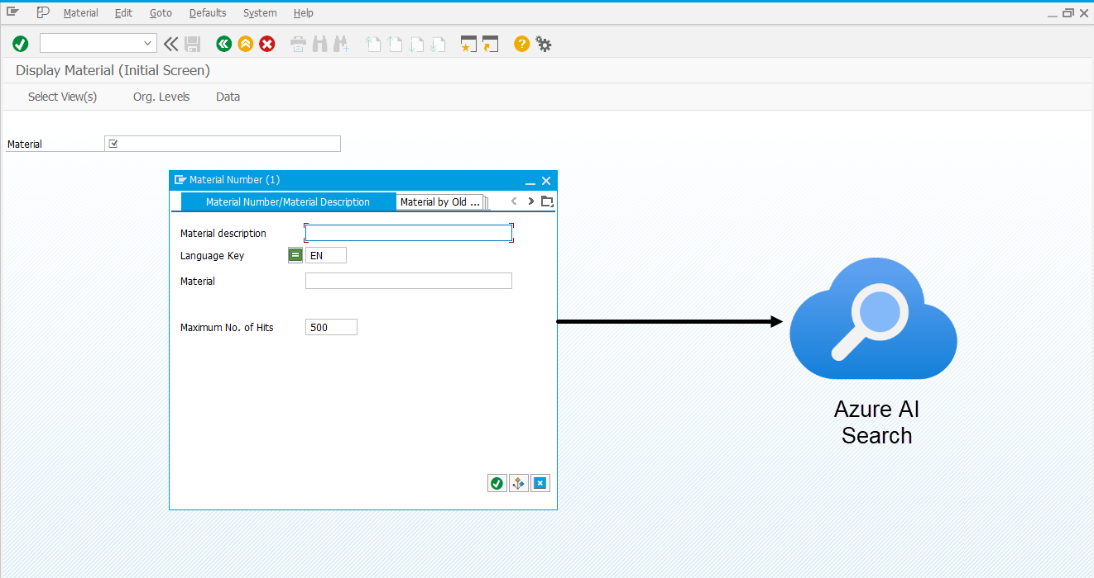
Use Case: AI-Based Search (Cont.)
Models can be consumed directly from SAP GUI, Web Dynpro, or Fiori apps

Slide 22
Use Case: Text Processing with Generative AI
Scenario: You have transactional documents such as customer service orders or contracts that contain lots of detail. You want to generate a summary of that document so that key stakeholders can get up to speed fast.
Approach:
The target transaction(s) are enhanced with custom buttons to initiate a summarization request.
Whenever a user clicks the button, data from the selected document is gathered and sent to a web service endpoint to summarize the text.
The results of the web service are then copied into the long text description of the document or perhaps an attachment.

Slide 23
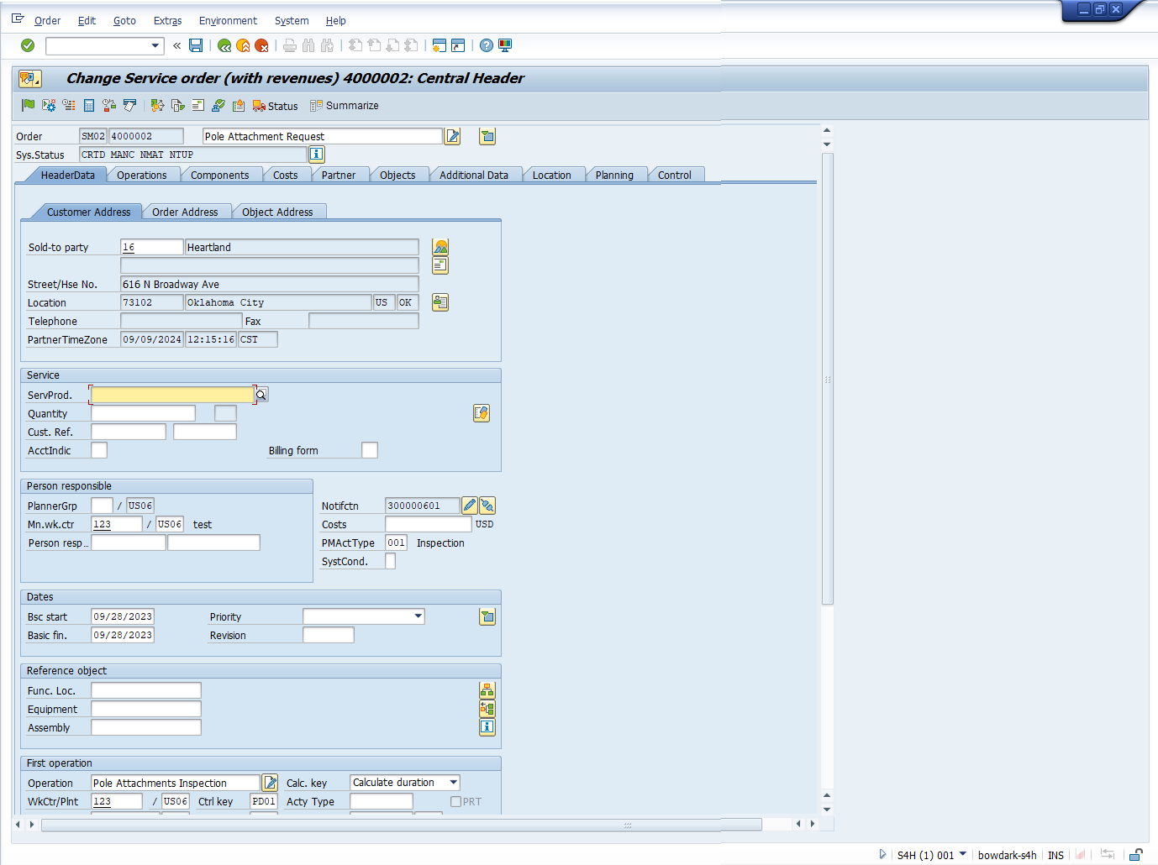
Use Case: Text Processing with Generative AI (Cont.)
ChatGPT 4o
Service order summary loaded into long text or as an attachment

Slide 24
Use Case: Language Translation
Scenario: You support a diverse base of users from multiple locales and need to translate incoming communications, etc.
Approach:
Write ABAP code to export data to blob storage or call a REST API.
Tune the AI model to consider the user locale and other nuances.
Retrieve the results and post language-specific long text updates.

Slide 25
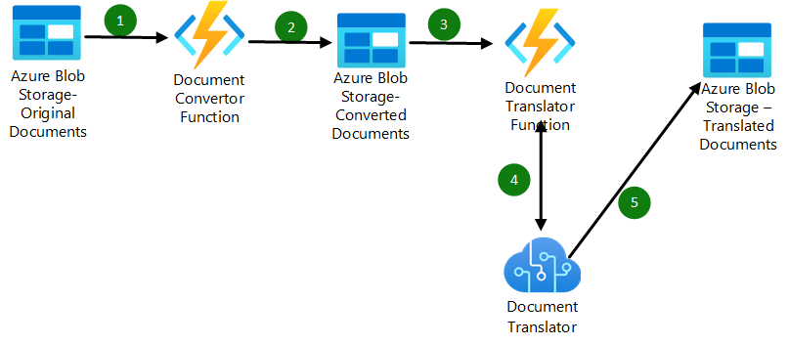
Use Case: Language Translation (Cont.)

Slide 26
Use Case: Low-Code Document Scanning
Scenario: You need to scan invoices or other physical documents and then load the data into SAP.
Approach:
You use a low-code modeling service like the Document Information Extraction service in SAP BTP or Microsoft’s AI Builder tool to train a model using previous documents (e.g., stored as attachments in SAP).
You build and publish a REST API around the trained AI model.
You integrate the REST API into new or pre-existing SAP transactions to enable users to upload documents, extract the data, and post it to SAP in one go (e.g., using a BAPI call).

Slide 27
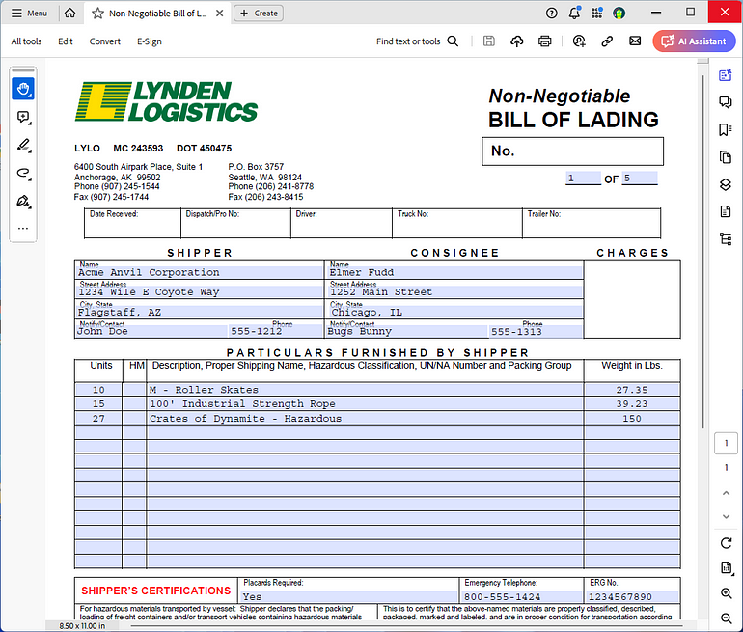
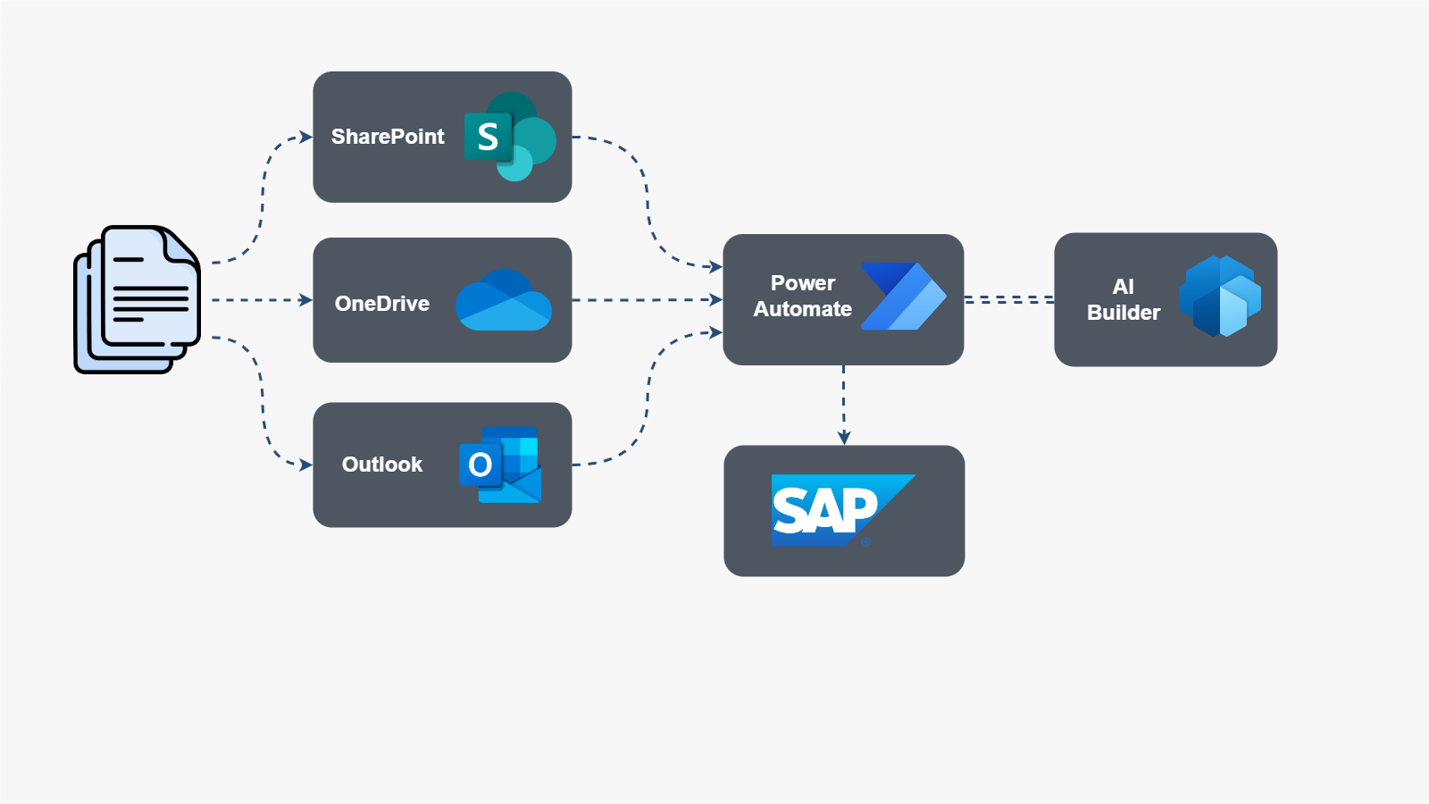
Use Case: Low-Code Document Scanning (Cont.)

Slide 28
Use Case: SAP Integration with Microsoft Copilot
Scenario: You want to incorporate SAP data and/or actions into custom chatbots built using Microsoft Copilot Studio.
Approach:
You use Microsoft’s standard connectors to create custom plugin actions in Copilot Studio that connect to SAP using RFM or OData services.
The built-in natural language processing capabilities of Copilot integrate these actions into the conversation flow.

Slide 29
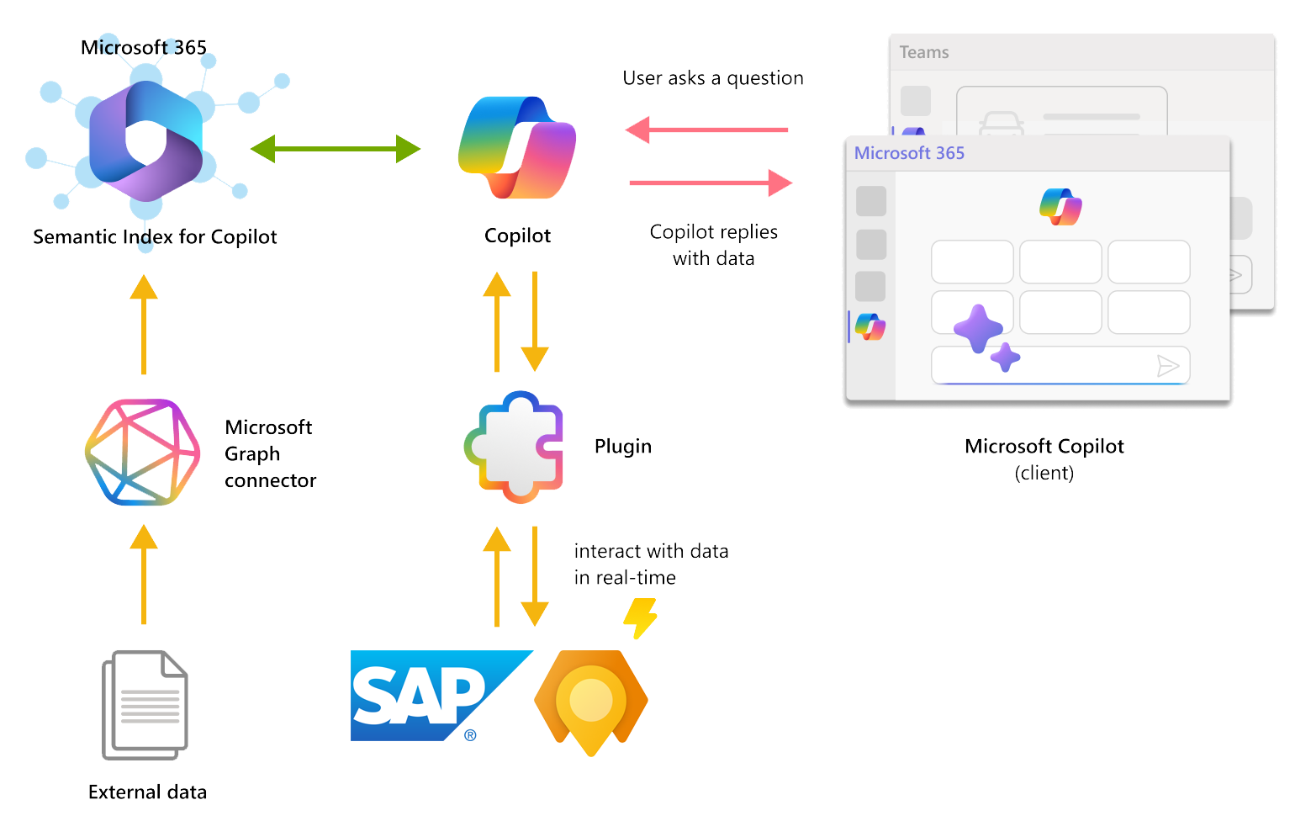
Use Case: SAP Integration with Microsoft Copilot (Cont.)

Slide 30
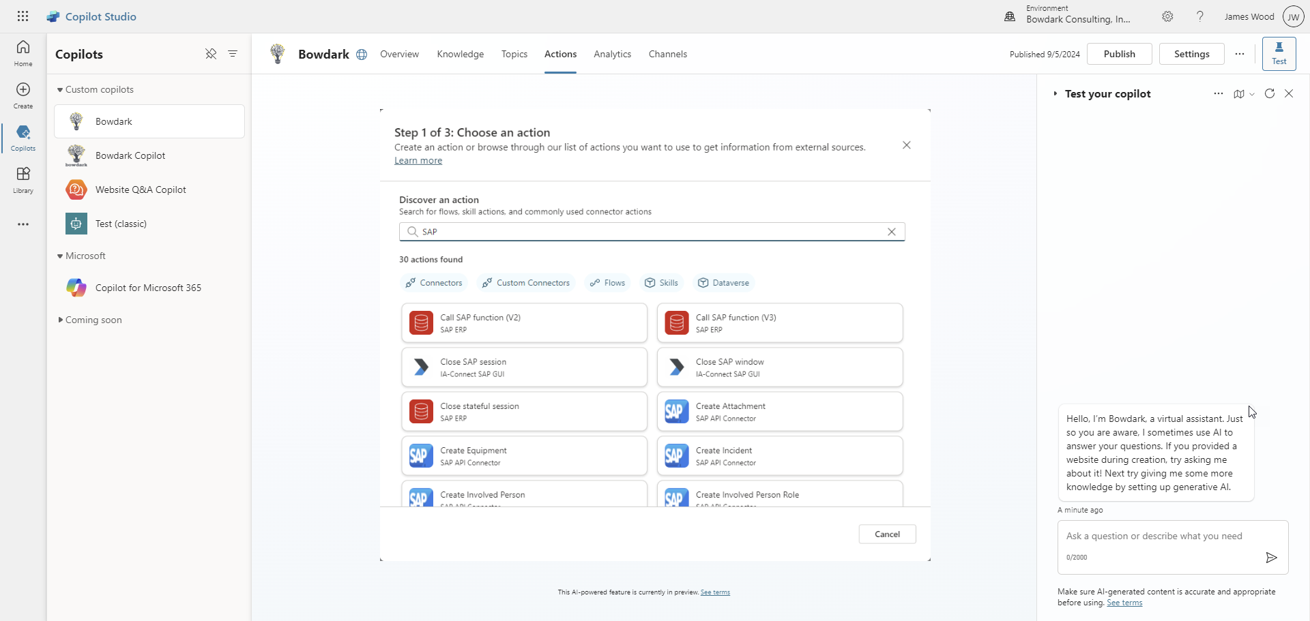
Use Case: SAP Integration with Microsoft Copilot (Cont.)

Slide 31
Transforming User Experiences: Moving Beyond Forms Over Data

Slide 32
Moving Beyond Forms Over Data
As we’ve seen, there are many ways to surgically infuse AI functionality into even the oldest of SAP systems.
While this approach can lead to some quick wins, there are greater opportunities to push the envelope with innovation.
Instead of just focusing on small transactional enhancements, it’s important to think about ways that AI could holistically transform process flows.
Sometimes the best app is no app at all.

Slide 33
Thinking Holistically About AI Transformations
Event Handlers / Workflows:
As transaction events occur, use AI models to analyze the results (e.g., anomaly detection) and predict/determine if follow-on actions are required.
Push vs. Pull: Proactively deliver work into the hands of the right people at the right time.
Reasoning & Context:
Before bringing a human being into the process, use reasoning and context to determine if we have enough data to process a request automatically.
Use entity detection to dynamically determine process context.
Use “document cracking” techniques to fetch data from semi-structured or unstructured data sources.

Slide 34
Thinking Holistically About AI Transformations (Cont.)
Cloud Data Platforms:
Cloud data platforms like Microsoft Fabric contain rules engines that can be used to create a sort of “digital nervous system” that monitors for anomalies.
Whenever these anomalies are detected, workflows can be triggered to analyze impacts using AI models and proactively respond.

Slide 35
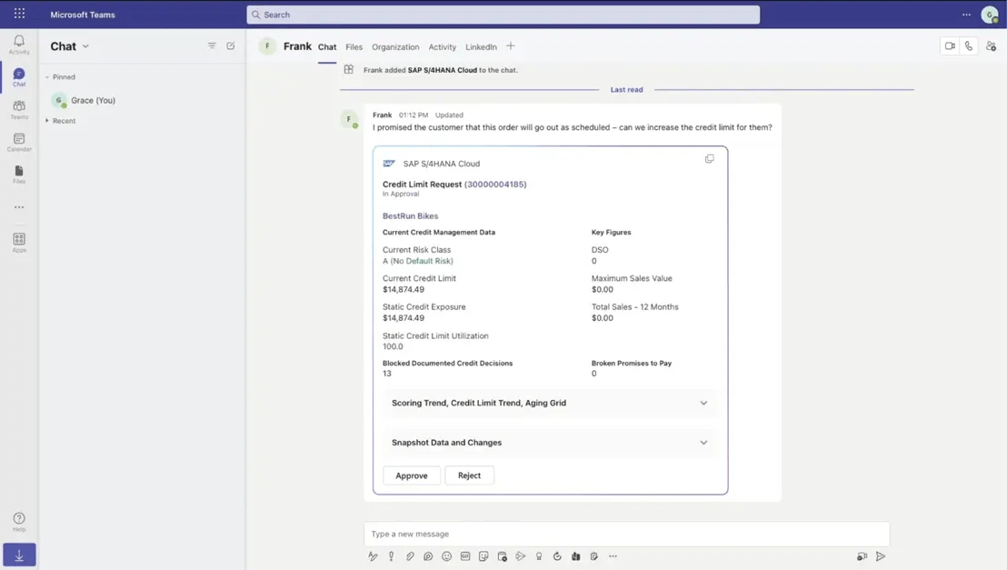
Integrating Decision Support Capabilities into Collaboration Tools

Slide 36
Detecting Anomalies at Scale Using Cloud Data Platforms

Slide 37
Reimagining User Experiences with AI-Based Agents

Slide 38
Wrap-up

Slide 39
Where to Find More Information
https://discovery-center.cloud.sap/viewServices?category=all
Catalog of available cloud services hosted on SAP BTP
https://learning.sap.com/learning-journeys/discovering-sap-activate-implementation-tools-and-methodology/discovering-the-clean-core-concept
SAP Learning journey describing SAP’s clean core philosophy
https://openai.com
Home page for OpenAI, the industry leader in generative AI solutions
https://www.tensorflow.org
Home page for one of the most popular AI frameworks that supports the development and execution of advanced neural networks, etc.

Slide 40
Key Points to Take Home
If you want to integrate AI functionality into on-premises SAP Business Suite systems, you will need to work with a cloud platform like SAP BTP.
For more elaborate scenarios, you can mix-and-match SAP BTP services with more advanced AI services from hyperscalers such as Microsoft, Amazon, or Google.
These approaches work for even the oldest of SAP NetWeaver systems.
While AI models are built/trained outside of SAP, you can easily integrate these models into everyday SAP transactions by calling REST APIs from custom ABAP code.
It’s important to look beyond the technical with AI integration and (re)consider ways to transform the user experience.

Slide 41
Please remember to complete your session evaluation.
James Wood
twitter.com/bowdark
linkedin.com/in/jwood029

